Slide 1


Introduction:
  Basic Concepts and Notations
  Complexity analysis: time space tradeoff
  Algorithmic notations, Big O notation
  Introduction to omega, theta and little o notation

Slide 2

Basic Concepts and Notations
Algorithm: Outline, the essence of a computational procedure, finite step-by-step instructions
Program: an implementation of an algorithm in some programming language
Data Structure: Organization of data needed to solve the problem

Slide 3
Classification of Data Structures
Data Structures
Primitive
Data Structures
Non-Primitive
Data Structures
Integer
Real
Character
Boolean
Linear
Data Structures
Non-Linear
Data Structures
Array
Stack
Queue
Linked List
Tree
Graph
Notes:
목차
자바의 생성배경
자바를 사용하는 이유
과거, 현재, 미래의 자바
자바의 발전과정
버전별 JDK에 대한 설명
자바와 C++의 차이점
자바의 성능
자바 관련 산업(?)의 경향

Slide 4
Data Structure Operations
Data Structures are processed by using certain operations.
Traversing: Accessing each record exactly once so that certain items in the record may be processed.
2.Searching: Finding the location of the record with a given key value, or finding the location of all the records that satisfy one or more conditions.
3.Inserting: Adding a new record to the structure.
4.Deleting: Removing a record from the structure.
Notes:
목차
자바의 생성배경
자바를 사용하는 이유
과거, 현재, 미래의 자바
자바의 발전과정
버전별 JDK에 대한 설명
자바와 C++의 차이점
자바의 성능
자바 관련 산업(?)의 경향

Slide 5
Special Data Structure-Operations
Sorting: Arranging the records in some logical order (Alphabetical or numerical order).
Merging: Combining the records in two different sorted files into a single sorted file.
Notes:
목차
자바의 생성배경
자바를 사용하는 이유
과거, 현재, 미래의 자바
자바의 발전과정
버전별 JDK에 대한 설명
자바와 C++의 차이점
자바의 성능
자바 관련 산업(?)의 경향

Slide 6
What is the use of data structure and algorithm ?
Solve the problem more efficiently
Data structures help to run program more efficient
Performance evaluation for each approach
All the above

Slide 7
INTRODUCTION OF ALGORITHMS
Algorithms introduced by Persian Author, Abu Ja’far Mohammed bin Musa al Khowarizmi (c. 825 A.D).
Definition: - An algorithm is a finite set of instruction that, if followed, accomplishes a particular task.
All algorithms must satisfy the following five properties that are widely accepted as requirements for an algorithm:
    Finiteness
    Definiteness
    Input
    Output
    Effectiveness

Slide 8
Algorithmic Problem
Specification of input
Specification of output as a function of input
?
Infinite number of input instances satisfying the specification. For example: A sorted, non-decreasing sequence of natural numbers of non-zero, finite length:
  1, 20, 908, 909, 100000, 1000000000.

Slide 9
Algorithmic Solution
Specification of input
Specification of output as a function of input
Algorithm
Algorithm describes actions on the input instance
Infinitely many correct algorithms for the same algorithmic problem

Slide 10
What is a Good Algorithm?
Efficient:
  Running time
  Space used
Efficiency as a function of input size:
  The number of bits in an input number
  Number of data elements(numbers, points)

Slide 11
Complexity analysis
Why we should analyze algorithms?
  Predict the resources that the algorithm requires
    Computational time (CPU consumption)
    Memory space (RAM consumption)
    Communication bandwidth consumption
  The running time of an algorithm is:
    The total number of primitive operations executed (machine independent steps)
    Also known as algorithm complexity

Slide 12
Time and Space Complexity
Space Complexity:- A fixed part that is independent of the characteristics of input and output. i.e., space for simple variable and fixed size component variable (also called aggregate).
The space needed by referenced variable and recursion stack space.
The space requirement S(P) of any algorithm P as:
S(P)=c + S_{p}
Where c is a Constant, S_{p} is an instance characteristics.

Slide 13
Time Complexity:-The time T(P) taken by a program P is the sum of the compile time and the sum of run (or execution) time.
Note: -The compile time does not depend on the instance characteristics.
An execution time independent of the instance characteristics.
The number of step any program statement is assigned depends on the kind of statement.

Slide 14
Method to calculate Time Complexity
The number of steps needed by a program to solve a particular problem instance in one of two ways.
using variable.
Using table.

Slide 15
First Method - using variable
Algorithm Sum(a,n) { s=0.0; for ( i:=1 to n do) s:=s+a[i]; return s; } | Algorithm Sum(a,n) { count=0; s=0.0; count:=count+1; // For s variable. // count is global ,it is initially zero. for ( i:=1 to n do) { count++; //For for loop s:=s+a[i]; count++;// for assignment } count++;//For last time for loop count++// For Return return s; }

Slide 16
Second method - Using table
Algorithm | S/E | Frequency | Total Steps
Algorithm Sum(a,n) { s=0.0; for ( i:=1 to n do) s:=s+a[i]; return s; } | 0 0 1 1 1 1 0 | __ __ 1 n+1 n 1 _ | 0 0 1 n+1 n 1 0
Total |  |  | 2n+3
CSE 205 @ Lovely Professional University

Slide 17
An execution time independent of the __________
Program steps
instance steps
Instance characteristics
None of the above
CSE 205 @ Lovely Professional University

Slide 18
Time Complexity
Worst-case
  An upper bound on the running time for any input of given size
Average-case
  Assume all inputs of a given size are equally likely
Best-case
  The lower bound on the running time

Slide 19
Time Complexity – Example
Sequential search in a list of size n
  Worst-case:
    n comparisons
  Best-case:
    1 comparison
  Average-case:
    n/2 comparisons

Slide 20
Complexity may be ___
  Worst-case
  Best-case
  Average-case
  All The above

Slide 21
Time & Space tradeoff
A time space tradeoff is a situation where the memory use can be reduced at the cost of slower program execution (and, conversely, the computation time can be reduced at the cost of increased memory use).
A space-time or time-memory tradeoff is a way of solving a problem or calculation in less time by using more storage space (or memory), or by solving a problem in very little space by spending a long time.

Slide 22
As the relative costs of CPU cycles, RAM space, and hard drive space change—hard drive space has for some time been getting cheaper at a much faster rate than other components of computers—the appropriate choices for time space tradeoff have changed radically.
Often, by exploiting a time space tradeoff, a program can be made to run much faster.

Slide 23
Asymptotic Notations
Algorithm complexity is rough estimation of the number of steps performed by given computation depending on the size of the input data.
Does not depend upon machine, programming language etc.
No need to implement, we can analyze algorithm.

Slide 24
O (Big O/Exact or Upper) Notation
The function f(n)=O(g(n)) [read as f of n is big oh of g of n] if and only if there exist positive constants c and n₀ Such that f(n) ≤c*g(n) for all n, n ≥ n_{0.}
In other words, f (n)=O(g(n)) if and only if there exist positive constants c, and n₀. , such that for all n ≥ n₀, the inequality 0≤f(n)≤c*g(n) is satisfied.
The statement f(n)= O (g(n)) states only that g(n) is an Upper bound for f (n) .

Slide 25
O(1) < O(log n) < O(n) < O(n log n) < O(n²) < O(n³) < O(2^{n})
Where
O(1) Computing time. That is constant.
O(n) is called Linear
O(n2) is called Quadratic
O(n3) is called Cubic
O(2n) is called Exponential
f(n)=O(g(n)) states only that g(n) is an upper bound on the value of f(n) for all n, n ≥ n_{0.}

Slide 26

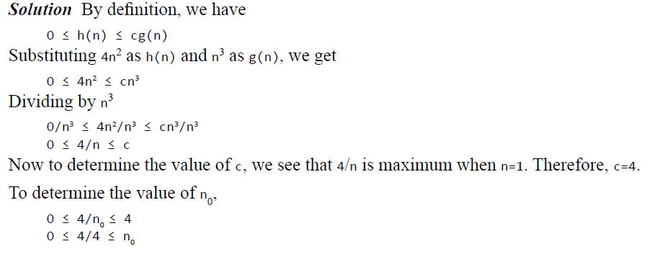


Slide 27

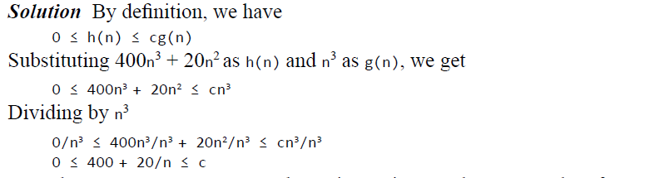


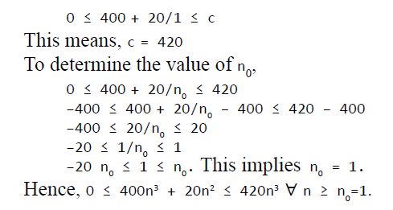

Slide 28
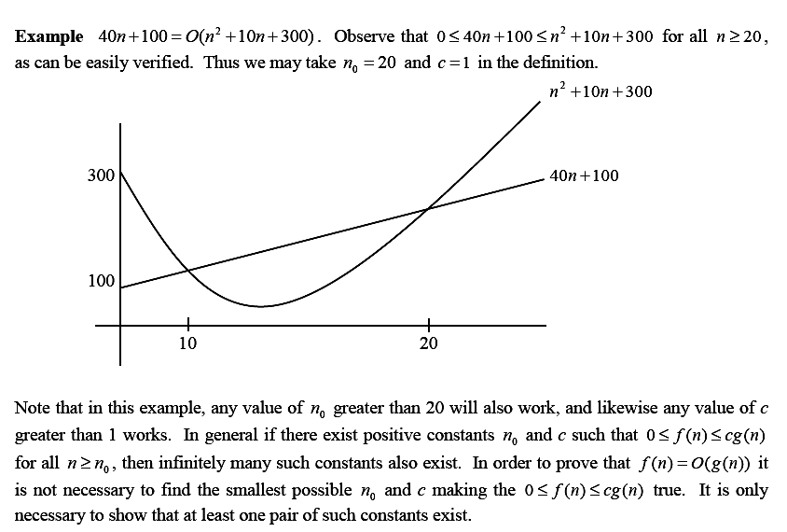
CSE 205 @ Lovely Professional University

Slide 29
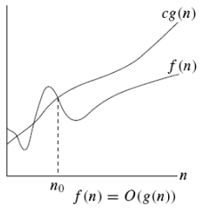

O-notation
Asymptotic upper bound

Slide 30
Ω (Omega / Exact /Lower) Notation
The function f(n)=Ω(g(n)) (read as “f of n is omega of g of n”) iff there exist positive constants c and n₀ such that f(n) ≥ c*g(n) for all n, n≥ n_{0.}
The statement f(n)= Ω (g(n)) states only that g(n) is an lower bound for f (n) .
CSE 205 @ Lovely Professional University

Slide 31
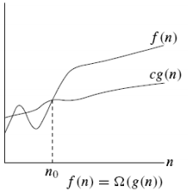


Slide 32

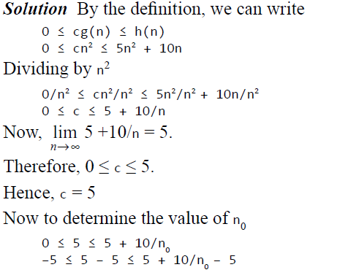
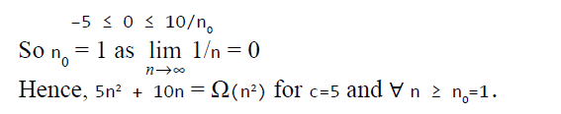

Slide 33
Example
When we say that the running time (no modifier) of an algorithm is Ω (g(n)).
we mean that no matter what particular input of size n is chosen for each value of n, the running time on that input is at least a constant times g(n), for sufficiently large n.
  n³ + 20n ∈ Ω(n²)

Slide 34
Θ (Theta/ Exact) Notation
The function f(n) = Θ(g(n)) if there exist positive constants n0, c1, andc2 such that to the right of n0, the value of f(n) always lies between c1* g(n) and c2*g(n) inclusive.
i.e. c₁*g(n) ≤ f(n) ≤ c₂*g(n)
The function f(n) = Θ(g(n)) is both upper and lower bound on f(n).
CSE 205 @ Lovely Professional University

Slide 35

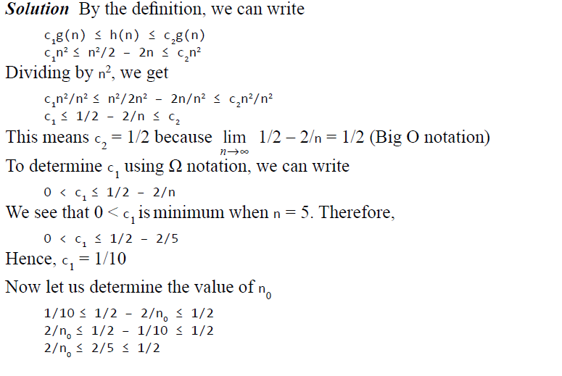

Slide 36
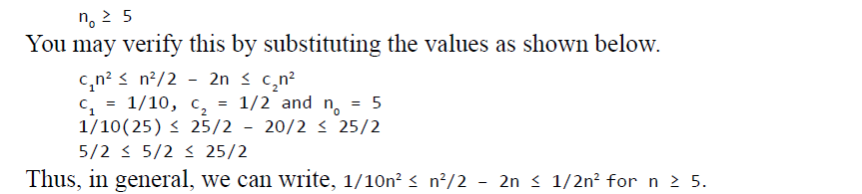

Slide 37
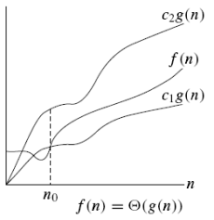


Slide 38
Which notation is lower bound ?
Big O
Omega
Theta
None of the above .
CSE 205 @ Lovely Professional University

Slide 39
Basic rules
1. Nested loops are multiplied together.
2. Sequential loops are added.
3. Only the largest term is kept, all others are dropped.
4. Constants are dropped.
5. Conditional checks are constant (i.e. 1).

Slide 40
for(int i = 0; i < n; i++) {
cout << i << endl;
}
O(n)
O(2n+1)
O(n+1)
None of the above

Slide 41
for(int i = 0; i < n; i++) {
for(int j = 0; j < n; j++){
//do swap stuff, constant time
}
}
O(4n^2)
O(n^2)
O(n^2+2)
O(n)

Slide 42





Slide 43
What does it mean when we say that an algorithm X is asymptotically more efficient than Y?
X will always be a better choice for large inputs
X will always be a better choice for small inputs
Y will always be a better choice for small inputs
X will always be a better choice for all inputs

